Slide 1
Recurrent Neural Networks (RNN)

Slide 2
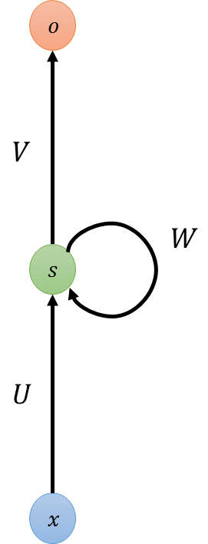














Recurrent Neural Networks
Neural Networks
Recurrent Neural Networks
$$o$$
$$o$$
$$o$$
$$o_{t−1}$$
$$o_{t}$$
$$o_{t+1}$$
...
...
$$s$$
$$s$$
$$s$$
$$s$$
$$s$$
$$s$$
$$s$$
$$s$$
$$x$$
$$x$$
$$x$$
$$x_{t−1}$$
$$x_{t}$$
$$x_{t+1}$$
Inputs and outputs are independent
Sequential inputs and outputs

Slide 3
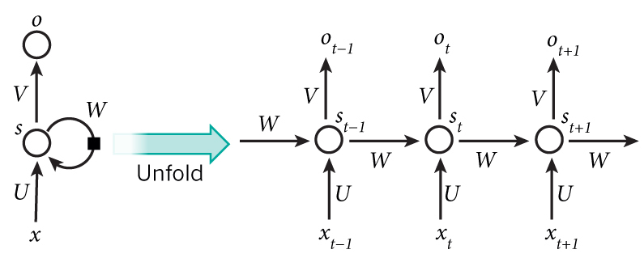
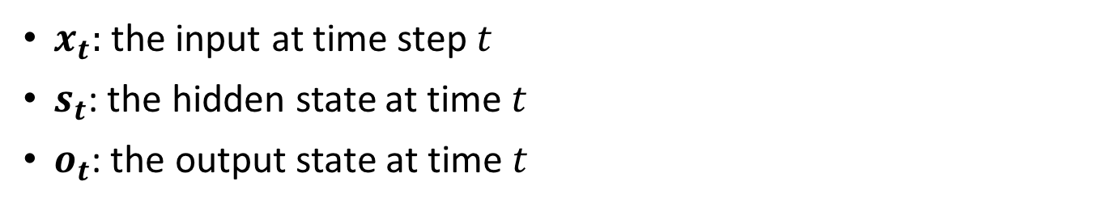
Unfolded Recurrent Neural Networks
RNN has an internal memory to process sequences of inputs.
$x_{t}:$ the input at time step $t$
$s_{t}$: the hidden state at time $t$
$o_{t}$: the output state at time $t$

Slide 4
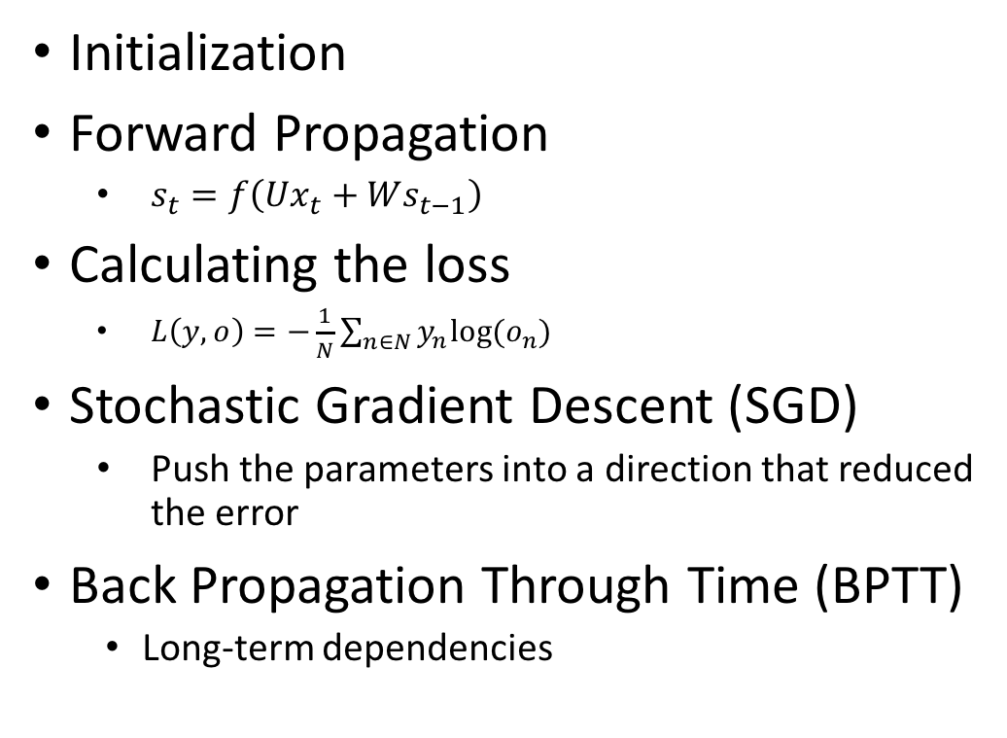
Overall Procedure
Initialization
Forward Propagation
$s_{t}=f\left(Ux_{t}+Ws_{t−1}\right)$
Calculating the loss
$L\left(y,o\right)=−\frac{1}{N}\sum_{n∈N}{y_{n}log⁡(o_{n})}$
Stochastic Gradient Descent (SGD)
Push the parameters into a direction that reduced the error
Back Propagation Through Time (BPTT)
Long-term dependencies
Back Propagation
Through Time (BPTT)

Slide 5
Vanishing Gradient Over Time
Standard RNN
The sensitivity of the input values decays over time
The network forgets the previous input
Long-Short Term Memory (LSTM)
The cell remember the input as long as it wants
The output can be used anytime it wants

Slide 6
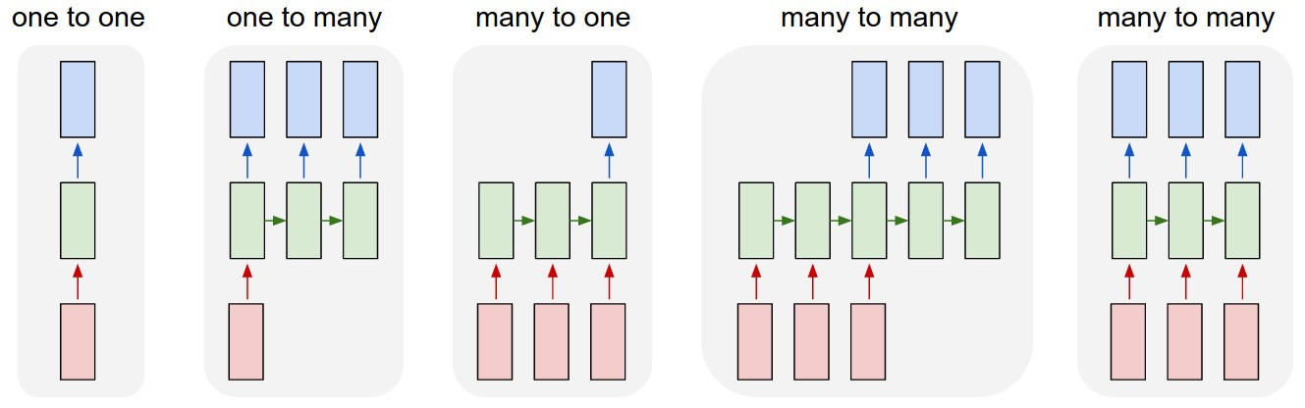
Design Patterns for RNN
Task | Input | Output
Image classification | fixed-sized image | fixed-sized class
Time-series forecasting | Sequential data | prediction
Sentiment analysis | sentence | positive or negative sentiment
Machine translation | sentence in English | sentence in French
Video classification | video sequence | label each frame

Slide 7



Implementation
Software
TensorFlow
Python
Numpy
Pandas
Data Preparation
Transform time-series data into batches
Split for training and validation

Slide 8
Evaluation
Advantages
Suitable for sequential data
Highly accurate with proper configuration
Disadvantages
Requires more training time and computation power
Tuning parameters is not straightforward

Slide 9
Hyper-parameter Tuning

Slide 10
Motivation
Machine Learning is extremely powerful
Tuning ML systems is extremely non-intuitive
“…We still don’t really know why some configurations of deep neural networks work in some cases and not others, let alone having a more or less automatic approach to determining the architectures and the parameters. “
- Xavier Amatriain, Director of Research at Quora

Slide 11
Tuning Machine Learning Models
Big Data
New Parameters
Optimization
Predictive Models
Better Models
Objective Metric

Slide 12
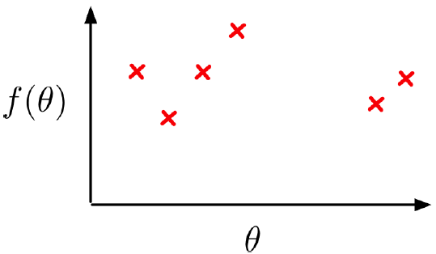
Bayesian Global Optimization
Optimize object function
Loss, Accuracy, Likelihood
Given parameters
Hyper-parameters, feature parameters
Find the best hyper-parameters
Sample function as few times as possible
Training on big data is expensive

Slide 13
How Does It Work?
Build Gaussian Process (GP) with points sampled so far
Optimize the fit of the GP (covariance hyper-parameters)
Find the point(s) of the highest Expected Improvement within parameter domain
Return optimal next best point(s) to sample

Slide 14
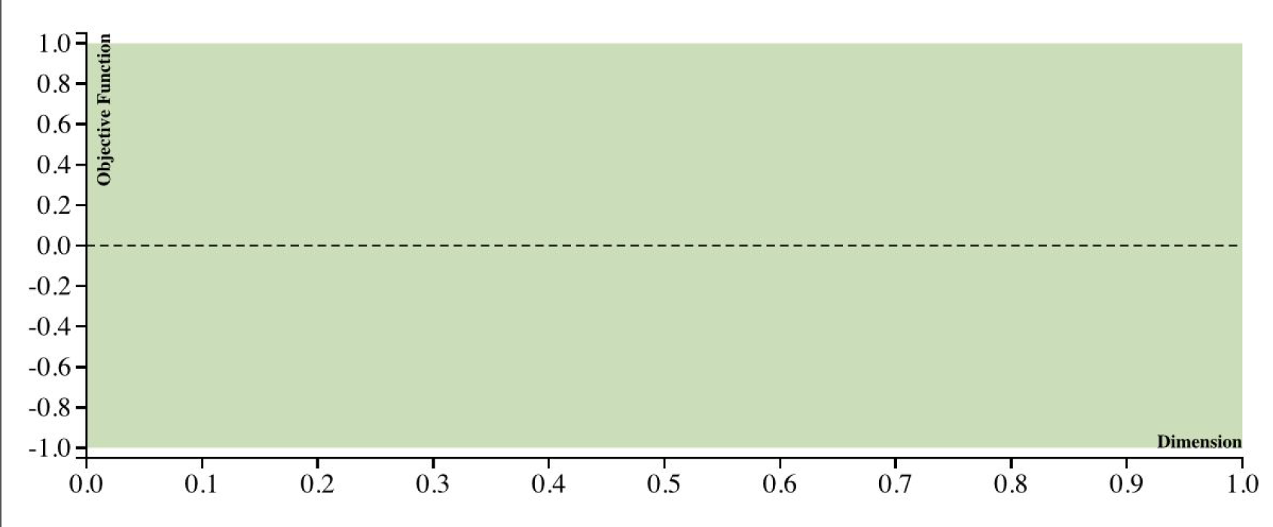
Gaussian Process

Slide 15
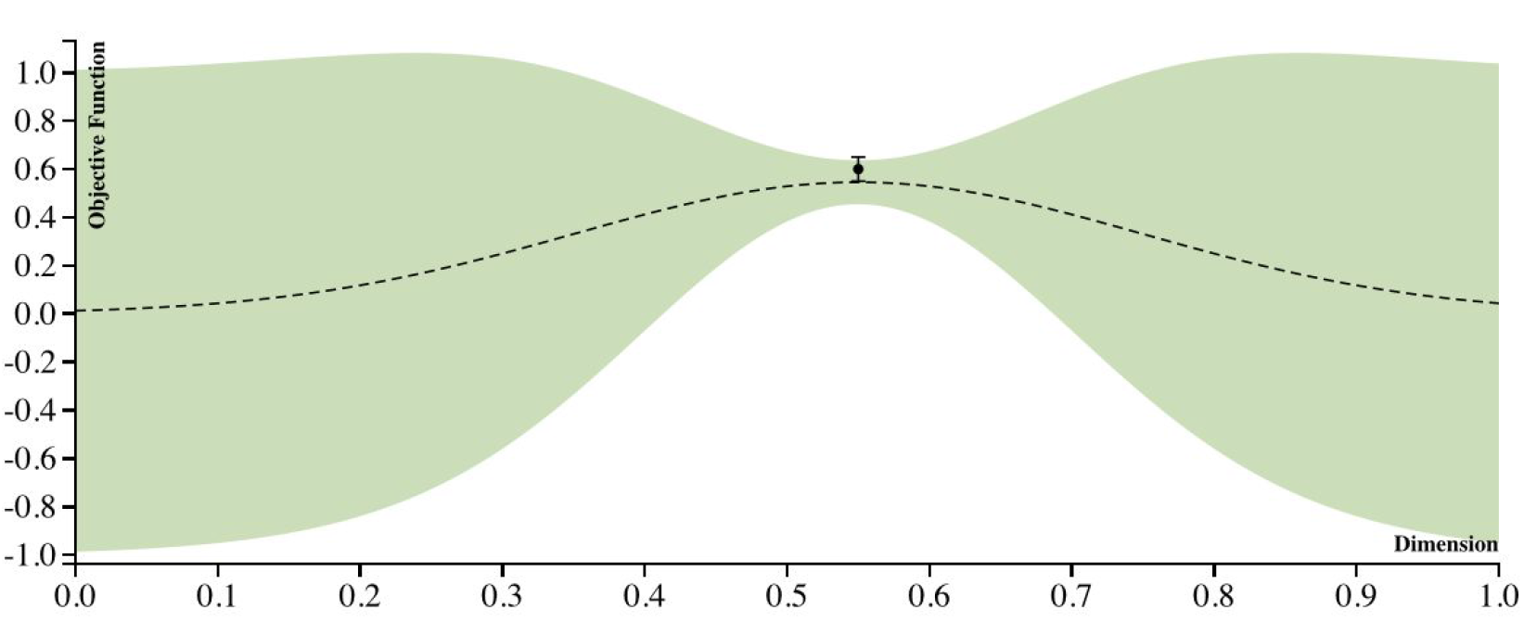
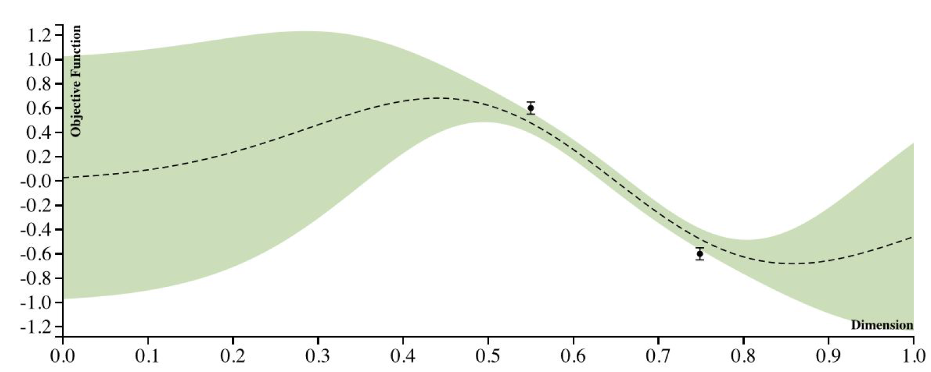
Gaussian Process

Slide 16
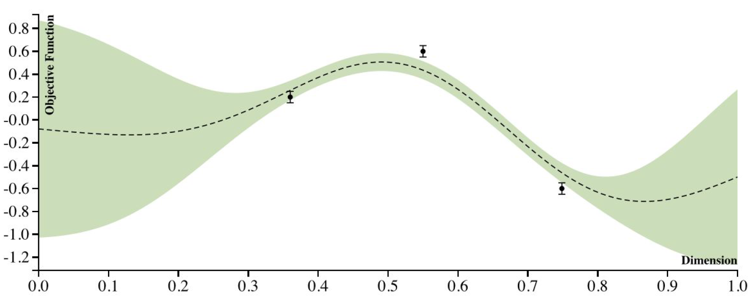
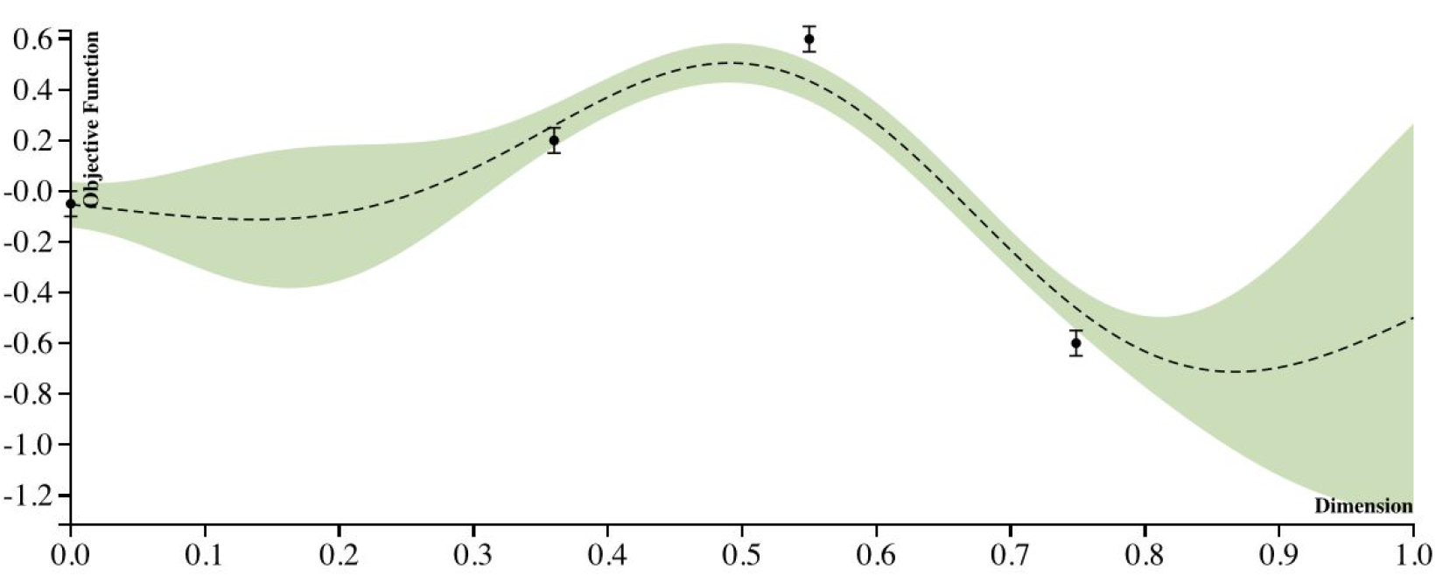
Gaussian Process

Slide 17
Implementation
Bayesian-optimization
https://github.com/fmfn/BayesianOptimization
Define our target function
Define parameters we want to tune
BO will return the optimized parameters
F = (prediction – actual) ** 2
Params = {
num_layers: (1, 10)
.. ..
}
BO.maximize(F, params) -> return optimized params

Slide 18
Evaluation
Fast
Quickly optimize objective function
Customizable
Parameters, iterations
More confident in tuning
Integrated into our framework

Slide 19
Additional Slides

Slide 20
Timeline
Week 2: Understand the problem
Week 3-5: Five models can produce prediction results
Week 6-7: Optimization of five models
Week 8: Wrap up, Visualization, Benchmarking, Documentation.

Slide 21
Forecast Results
Forecast results (in csv and graph)

Slide 22
Prepare the time series data
Raw data
(100%)
Train
(80%)
Test
(20%)
Train
(80%)
Validation
(20%)
Test
(20%)
64%
16%
20%

Slide 23





Prepare the time series data
x #01
[1, 2, 3, …,10]
split_squeeze
1
2
3
…
10
$$x_{t−9}$$
$$x_{t−8}$$
$$x_{t−7}$$
$$…$$
$$x_{t}$$

